Slide 5
Three Interpretations of Entropy
The amount of information an event provides
An infrequently occurring event provides more information than a frequently occurring event
The uncertainty in the outcome of an event
Systems with one very common event have less entropy than systems with many equally probable events
The dispersion in the probability distribution
An image of a single amplitude has a less disperse histogram than an image of many greyscales
the lower dispersion implies lower entropy

Slide 6
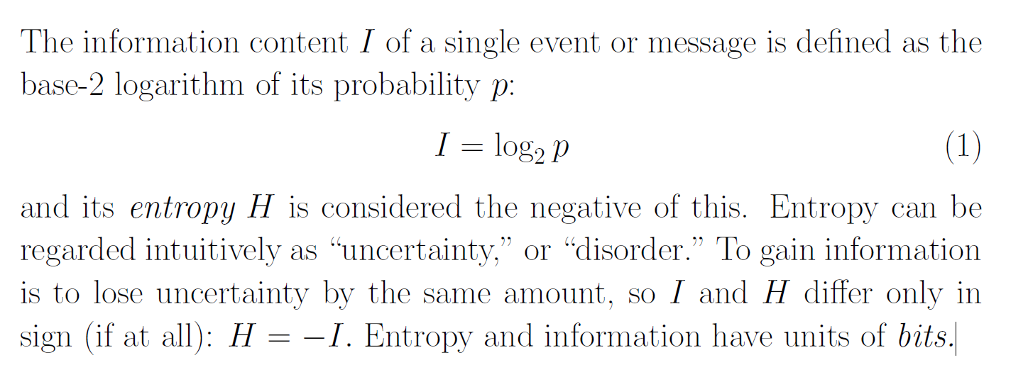

Slide 8


